Slide 1

DriverPass System Analysis
Patrick Ogarr
Notes:
[No speaker notes required for this slide.]

Slide 2

System Requirements
Functional Requirements
Students can schedule, cancel, and modify driving lessons online
Students can take online practice tests and view their progress
Non-Functional Requirements
The system must be accessible from any device
All user data and communication must be securely encrypted
Notes:
DriverPass needs the system to let students schedule, cancel, and change lessons online. Students also need to take practice tests and track their progress.
To support this, the system must work on phones, tablets, and computers. It must also protect user data by using strong encryption. These features make the system easy to use and safe for everyone

Slide 3
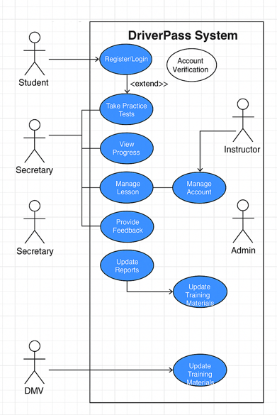
Use Case Diagram
Notes:
This diagram shows how everyone uses the DriverPass system. Students can sign in, take practice tests, check their progress, and manage lessons. Secretaries help schedule or cancel lessons. Instructors leave feedback after lessons. Admins manage user accounts and reports. The DMV sends updates to keep training materials current. This setup helps everyone do their job easily and keeps DriverPass running smoothly

Slide 4
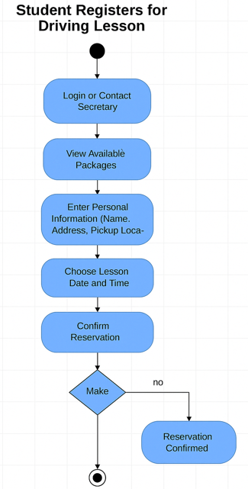
Activity Diagram
Notes:
This diagram shows the steps a student follows to sign up for a driving lesson. They first log in or call the secretary. Then they view the lesson packages and enter their personal details, like their name and pickup location. After choosing a date and time, they confirm their reservation. This makes it quick and easy for students to schedule lessons, helping DriverPass give better service

Slide 5
Security
Only users with the correct permission can see or
change information
Admins must use two-step login to protect their accounts
All data is encrypted to keep personal and payment
information safe
The system tracks who makes changes for accountability.
Regular backups protect the system from data loss
Notes:
We made sure the DriverPass system keeps information safe. Only people with the right permissions can see or change important information. Admins will use a two-step login for extra security. All student and payment information will be protected during use and when stored. These steps help keep DriverPass and its customers safe

Slide 6
System Limitations
An internet connection is required to use the system
Offline scheduling is not available
DMV updates might need manual checking if automatic updates fail
Changes to lesson packages must be done by technical staff
Notes:
This design has a few limits to keep in mind. Students and staff will need internet access to use the system. There is no offline option for scheduling. If DMV updates do not come through automatically, someone is required to manually check them. Also, if DriverPass wants to change the lesson packages in the future, a technical person will need to update the system

